Slide 1
Hierarchically organized behavior and its neural foundations: A reinforcement learning perspective (2008)
Model-based Hierarchical reinforcement learning
Stuart McIlroy
Based on the paper:
Matthew M. Botvinick Yael Niv Andrew C. Barto
Princeton Neuroscience Institute, Princeton University
United States University of Massachussetts, Amherst

Slide 2
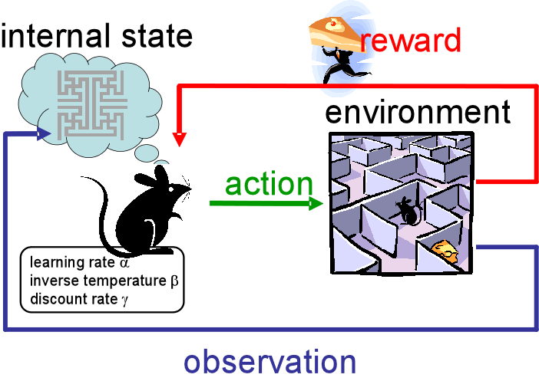
Goal of Botvinick’s paper
Demonstrate hierarchical reinforcement learning
Basic reinforcement learning

Slide 3



Model-based or model-free?
Model-based
Model-free
Policy Iteration
TD Learning

Slide 4



Td Learning (Model free)
$$δ \text{= }r_{t+1}\text{+ }γ\text{V}\text{(}s_{t+1}\text{) }\text{−} \text{V}\text{(}s_{t}\text{)}$$
$$V(s_{t}\text{) }← \text{V}\text{(}s_{t}\text{)}\text{ + }αδ$$
V=50
V=80
[]
R=100
$$δ=100+ .9∗0 −80=20$$
T=1
$$V\left(s_{t}\right)=80+ .1∗20=82$$
V=50
V=82
[]
R=100
T=2

Slide 5

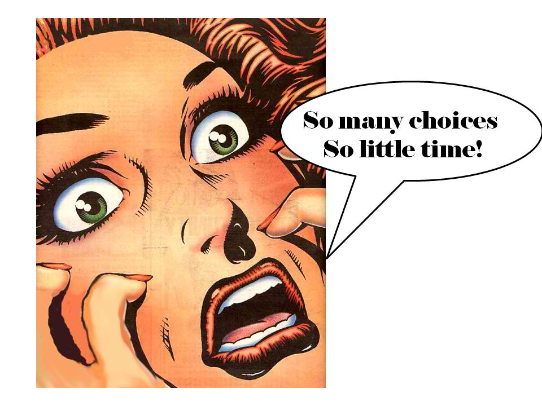
Simple RL techniques fail at large problems
Simple reinforcement techniques won’t scale as you add many states and actions

Slide 6
Hierarchical Organization of actions
Uses hierarchy of actions (called options)
“Make Coffee”
“put coffee in coffee maker”
“Pour coffee in mug”
“put sugar to coffee”
“put coffee in coffee maker”
Put under coffee maker
Press start
“Pour coffee”
Reach mug
Grab mug
Put in coffee
maker
“put sugar in coffee”
Grab spoon
Scoop sugar
Deposit sugar

Slide 7
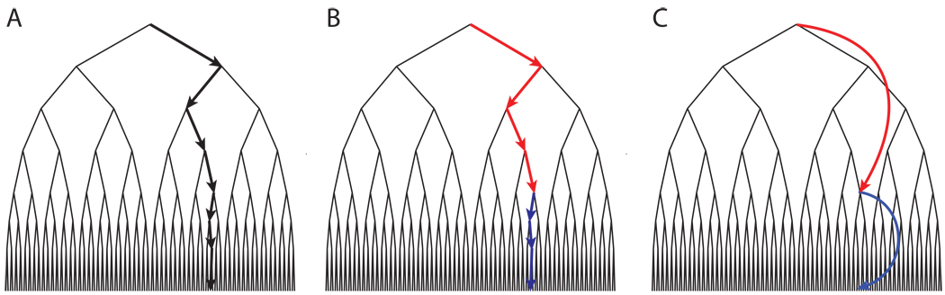
HRL learns faster than RL
Reduce size of search space
Learn faster; less parameters need to be adjusted (2 vs. 7)

Slide 8
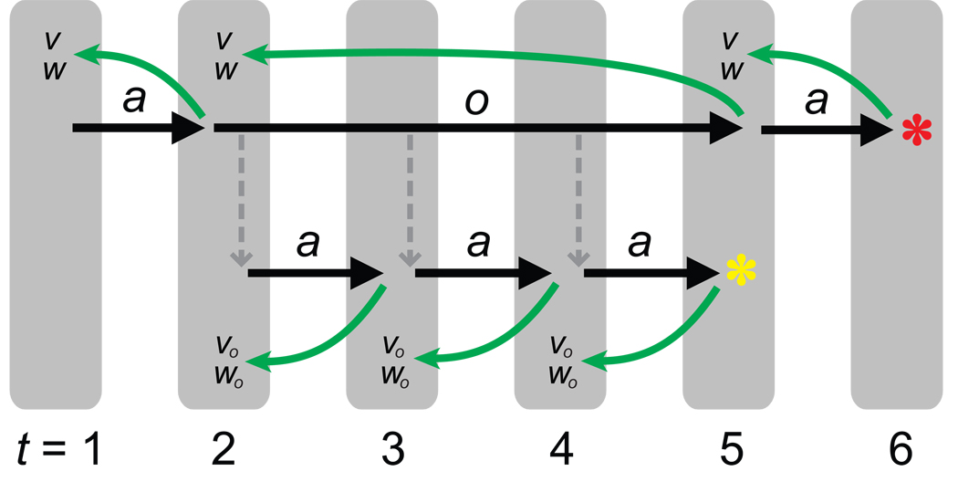

Combine Hierarchy with RL
a=action, o=option, V=state value, w= action weights, colored star=reward
Notes:
Two types of reward: External Reward (Red) and pseudo reward (yellow). Pseudo reward is given to attain the terminal states or sub-goals of an option. Then external reward is given at the end to determine if taking that option is a good thing or not.

Slide 9
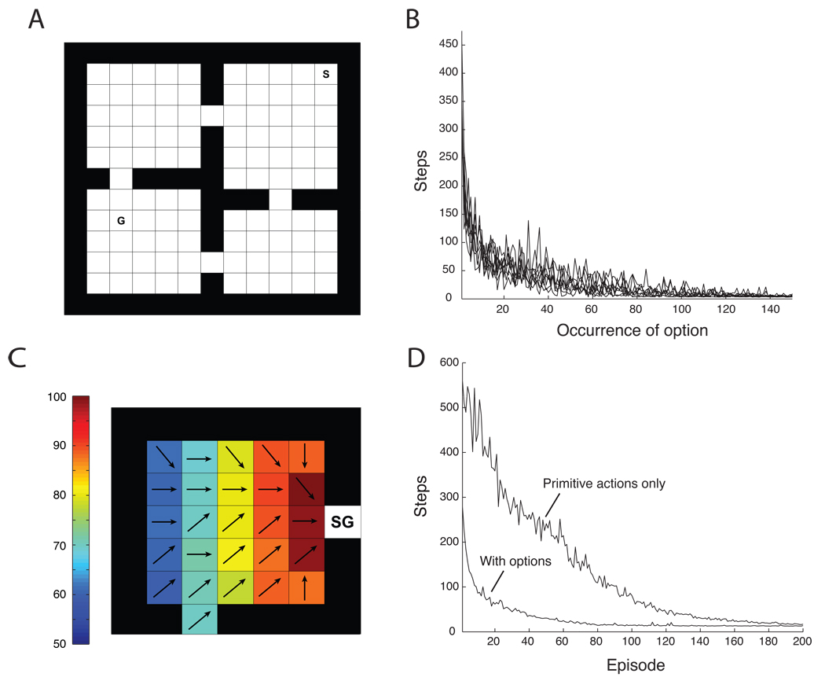
Botvinick’s experiments
Actions:
Left
Right
Up
Down
Go to door 1
Go to door 2
Go to door 3
Go to door 4

Slide 10
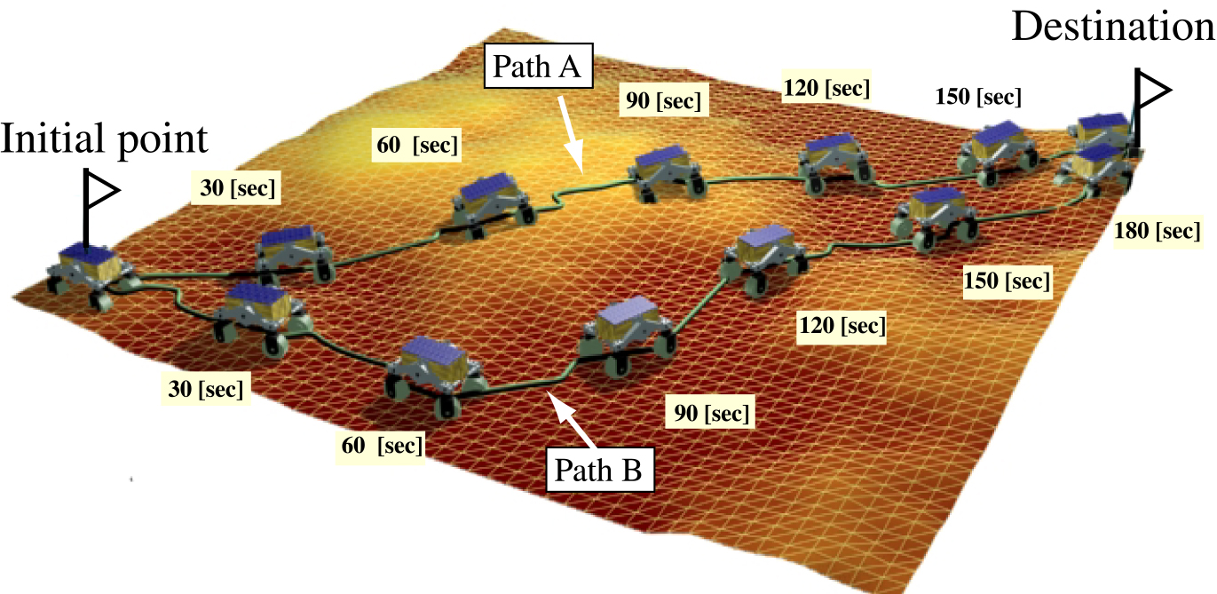


My approach: Model-based HRL
Plan your actions before you take them

Slide 11
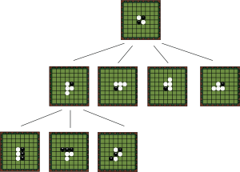

Monte Carlo Tree Search
.7
.1
.1
.1
.1
.3
.6
…
V:50
V:60

Slide 12
Benefits of MCTS
MCTS helps find the best solution because early on, the actions weights are very similar and so the agent can try different actions “in its head” without having to explore them. This speeds up learning.

Slide 13
Recap
Agent learns from reinforcement learning
Agent uses hierarchical actions to perform abstract actions
Agent models potential pathways to the goal and selects the best one

Slide 14
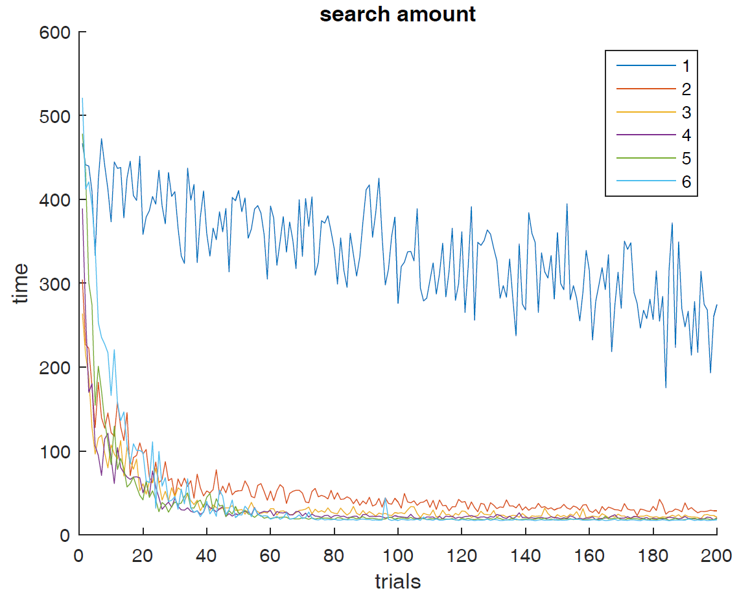



# of searches improves over model-free
Model free
Model based

Slide 15
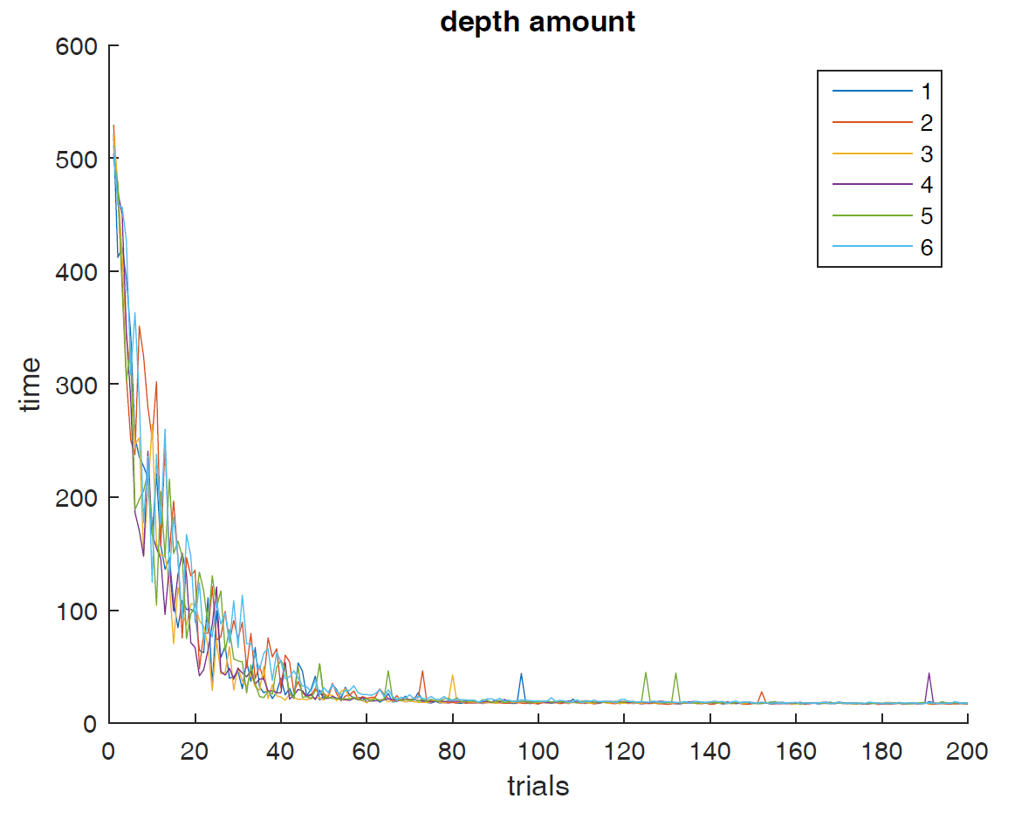
Inconclusive results on depth changes

Slide 16

Comparison to policy iteration
Policy iteration is faster.
But not feasible for hard problems like GO.
Too many states.

Slide 17

Benefits of MB MCTS HRL (yay acronyms!)
If the cost of making a move is more expensive then the cost of computational resources
Example: Robot arm

Slide 18
The end

Slide 19
Model-based MCTS
Tree search with max depth: max_d, max search attempts: max_s
Best_state = 0
While s < max_s:
State = Init_state
While d < max_d
Take action, get new state
If new state’s value V > best_state
Best_state = current state’s value V
set best_action to be first action taken in sequence

